Slide 1
Time series analysis

Slide 2
Time series
An ordered sequence of values of a variable at equally spaced time intervals
Different application areas
Economic forecasting
Sales forecasting
Budgeting analysis
Stick market analysis…
It is also known as discrete time stochastic process
We try to fit different statistical model to infer underlying relationships between series or predict future values
Serial dependence
A very important characteristic for financial time series
Serial correlation occurs when observations that are close together tend to be correlated
E.g. Volatility clustering

Slide 3
Time series modelling
Modelling a stochastic process Y(t) – that is a sequence of random variables
To forecast using such model we are interested in estimation of Y(t+h) using information available for n periods
Decomposition
Systematic – Trend, cycle, seasonality
Non-systematic – Noise
Decomposition type
Additive vs Multiplicative
Additive – T + C + S + N
Multiplicative – T X C X S X N

Slide 4
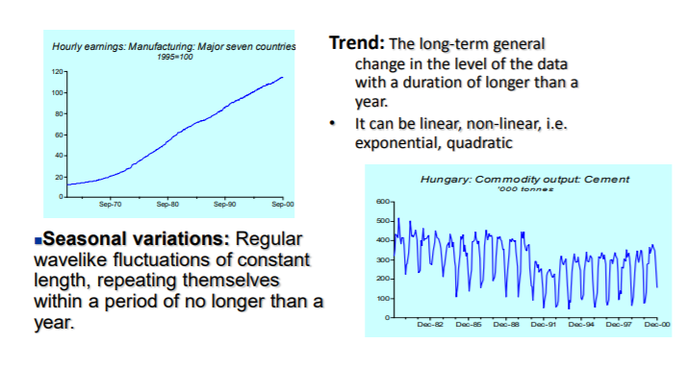
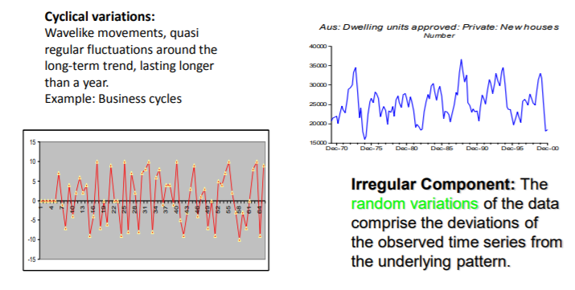
Component

Slide 5
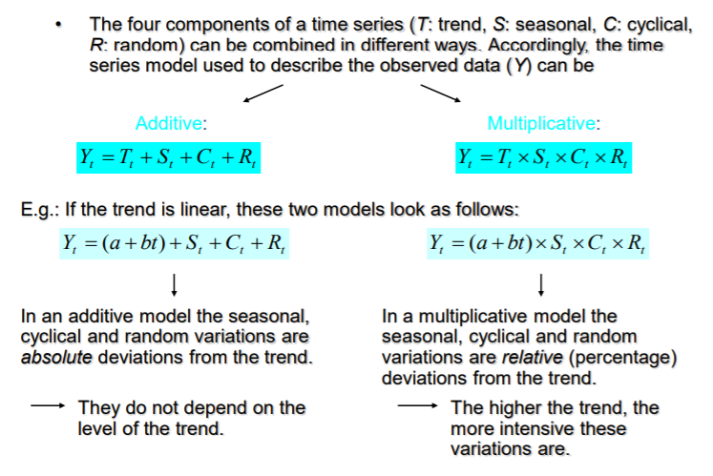
Additive vs Multiplicative models

Slide 6
Smoothing techniques
This is used to remove noises from the data
Highlight the other TS components
Two types – Moving average & exponential smoothing
Moving average
Arithmetic average of the values in that time period and those close to it
Exponential smoothing
Weighted average of all the available values up to that period
When the moving average period is high then along with the irregular component we also get rid of seasonal and cyclical component
We are left with trend component

Slide 7
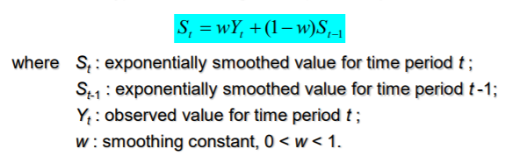
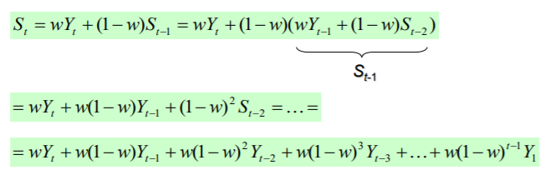
Exponential smoothing
It provides weights to observations

Slide 8
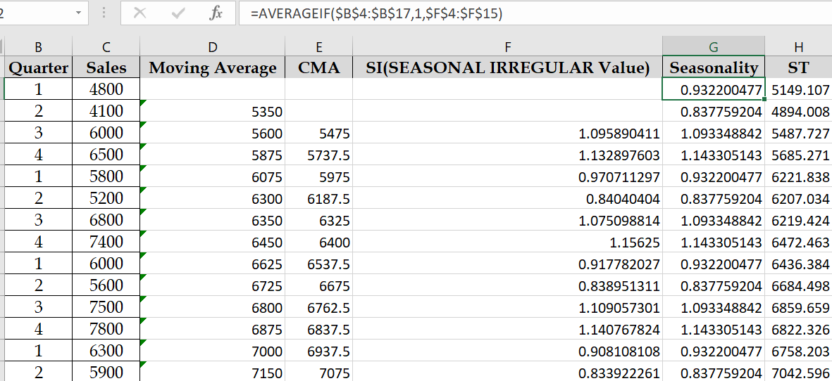
An example of time series analysis with excel
Year | Quarter | Sales
2009 | 1 | 4800
2009 | 2 | 4100
2009 | 3 | 6000
2009 | 4 | 6500
2010 | 1 | 5800
2010 | 2 | 5200
2010 | 3 | 6800
2010 | 4 | 7400
2011 | 1 | 6000
2011 | 2 | 5600
2011 | 3 | 7500
2011 | 4 | 7800
2012 | 1 | 6300
2012 | 2 | 5900
2012 | 3 | 8000
2012 | 4 | 8400
Moving Average(4)
Centralize
Find SI = sales / CMA Find seasonality for each quarter – average

Slide 9
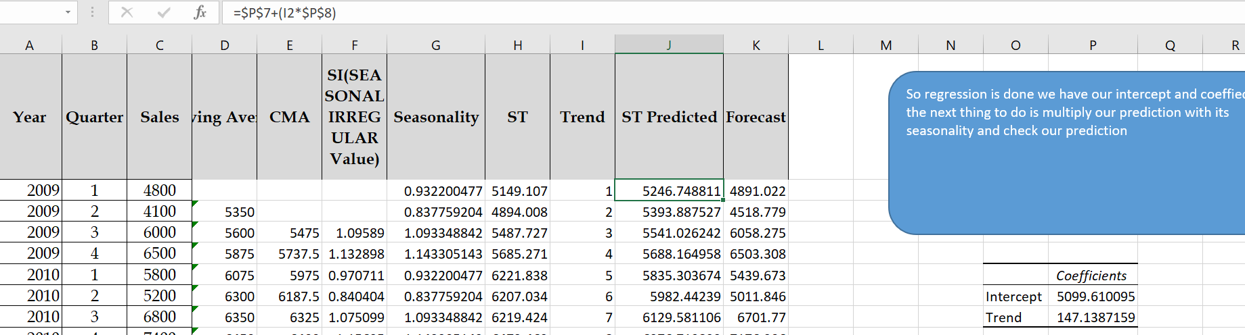
Contd..
Apply regression to this seasonality adjusted data
Using the regression model calculate the trend component
Using the trend and the seasonality forecast
Calculate the error

Slide 10


ARIMA
ARIMA is a combination of 3 parts
AR (Auto regressive)
Integrated
MA (Moving average)
Series should be stationary for both mean and variance

Slide 11
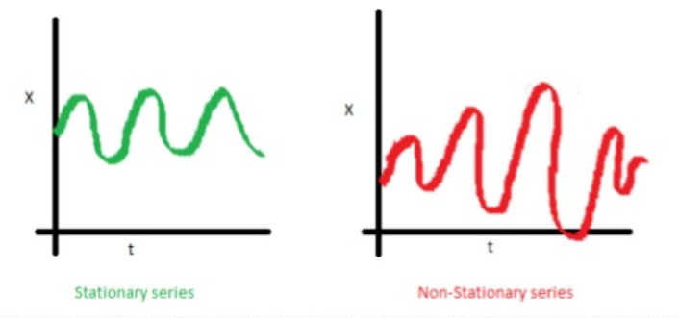
Contd..
A non seasonal ARIMA model is classified as an ARIMA(p,d,q) where:
P is the number of autoregressive terms
D is the number of non seasonal differences needed for stationarity
Q is the number of lagged forecast errors in the prediction equation (moving average terms)
If the series is non-stationary then it is made stationary by differencing

Slide 12
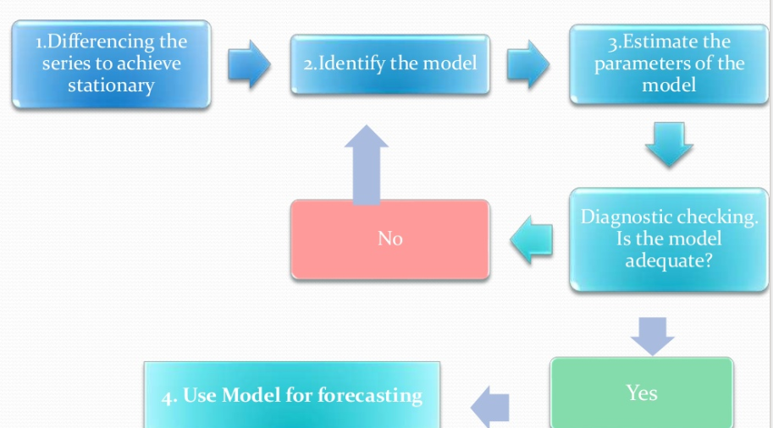
Box – Jenkins approach

Slide 13
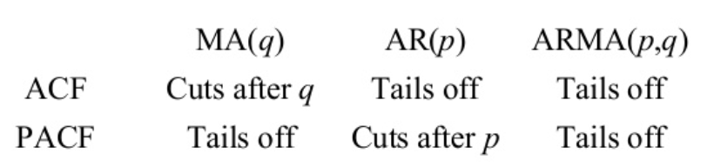
To determine p, q

Slide 14
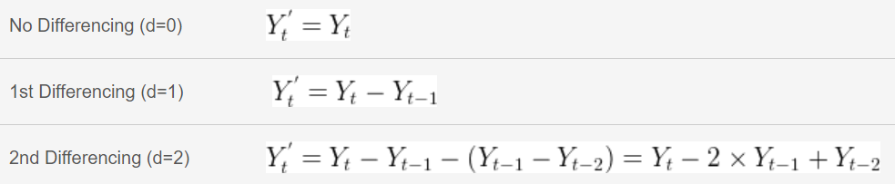
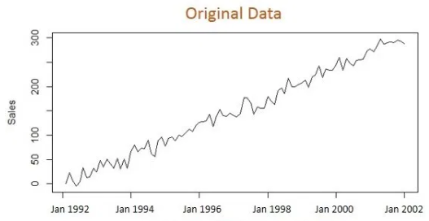
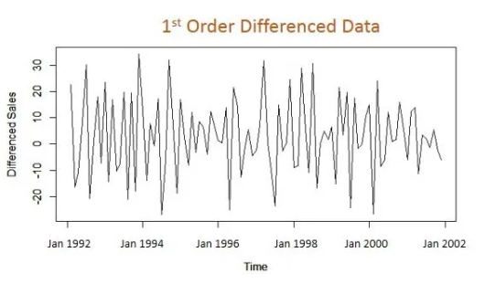
1st pass
Integrated
We extract trend from the original data series
Differencing is used as a mechanism to extract the trend

Slide 15
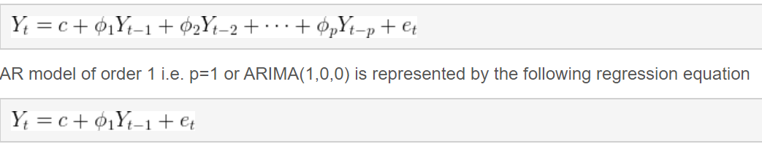
2nd pass
Autoregressive

Slide 16
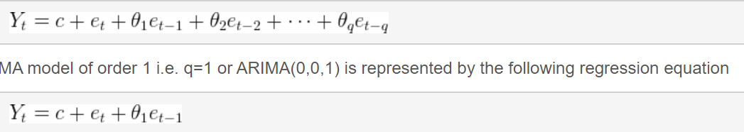
3rd pass
Moving average

Slide 17
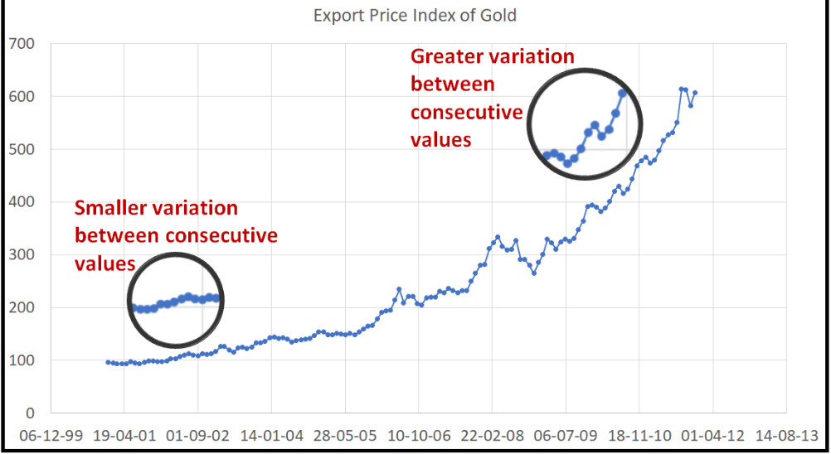
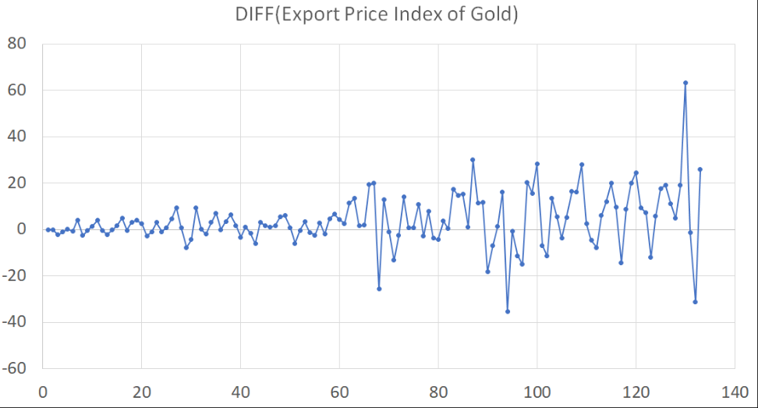
Heteroscedastic time series

Slide 18
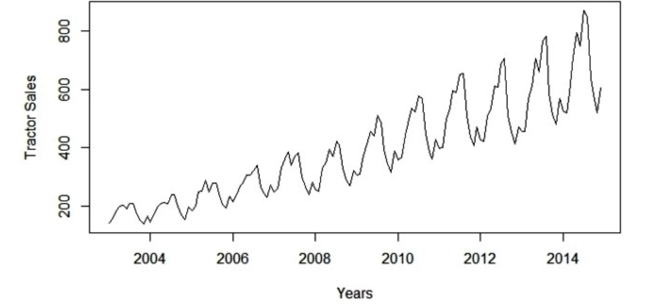
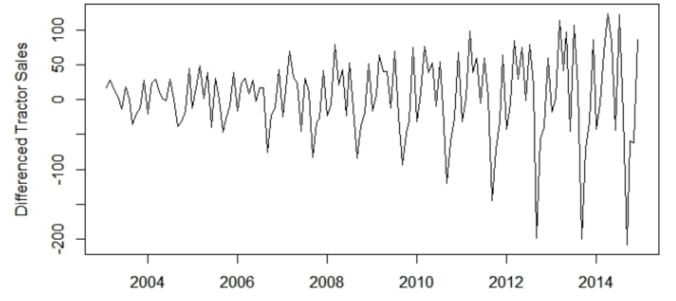
An example
Variance is increasing = not stationary

Slide 19
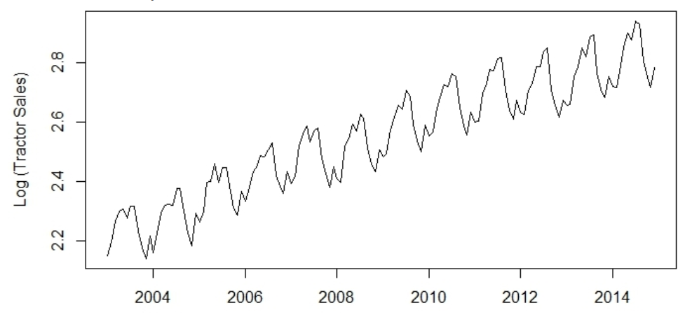
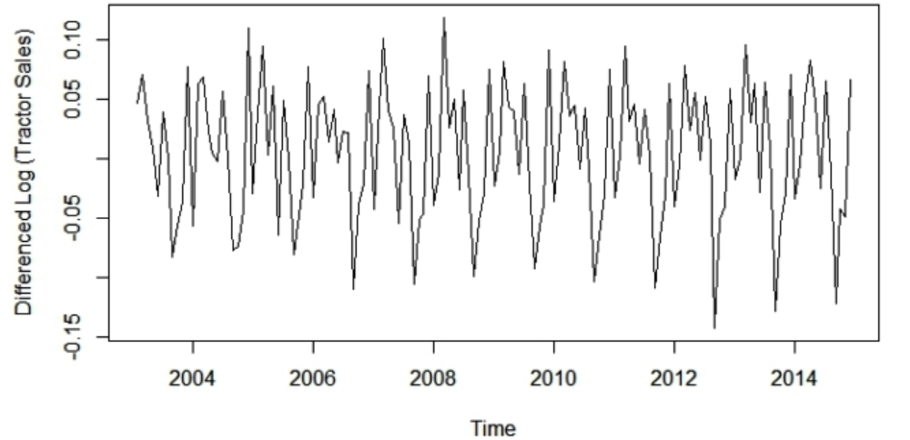
Contd..

Slide 20
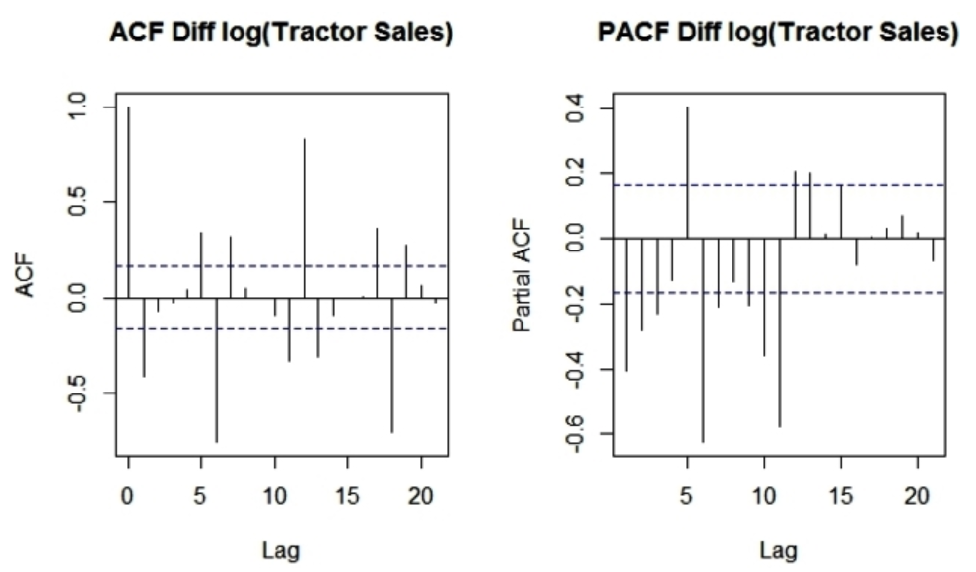
Contd..

